Slide 1
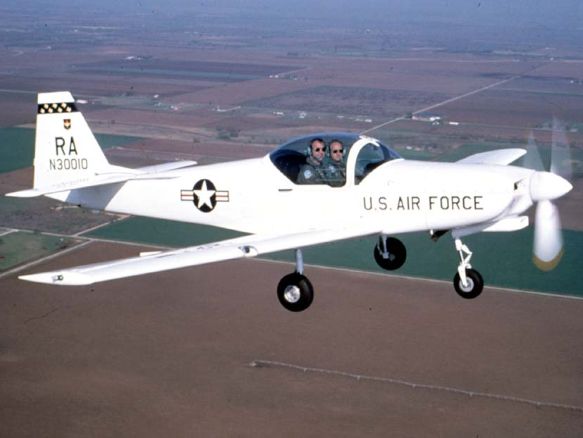
UConn – OPIM 5270 – Team 7
U.S. Air Force Project Firefly
Team 7 | OPIM 5270 | Final Project
Anita, Suriyaa, Thejes, Suraj and Luke

Slide 2
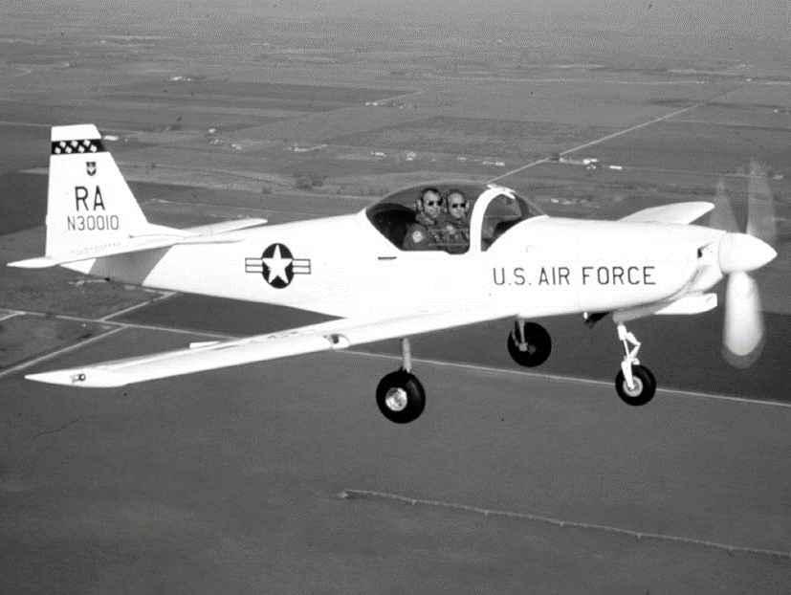


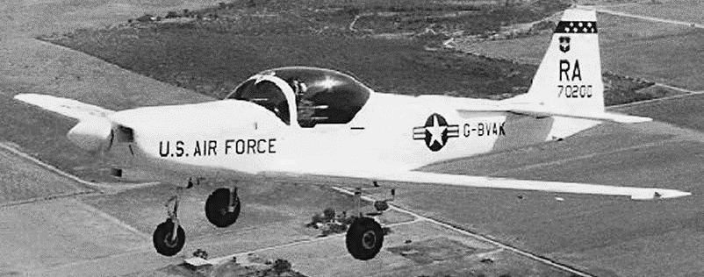
Project Background
UConn – OPIM 5270 – Team 7

Slide 3
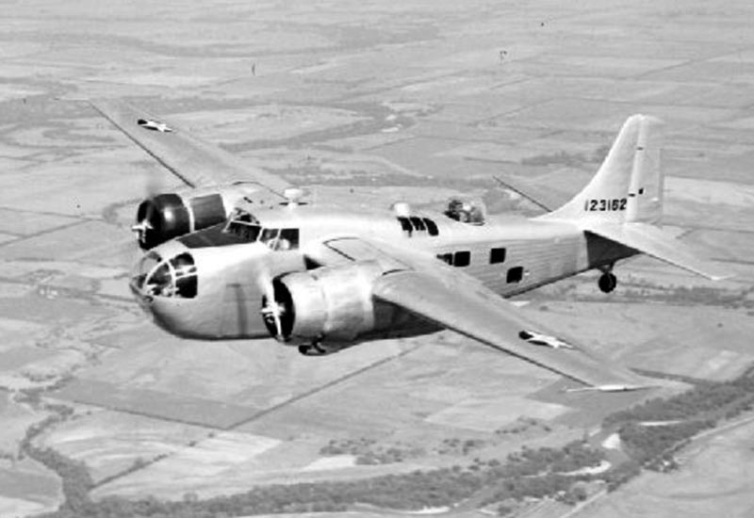
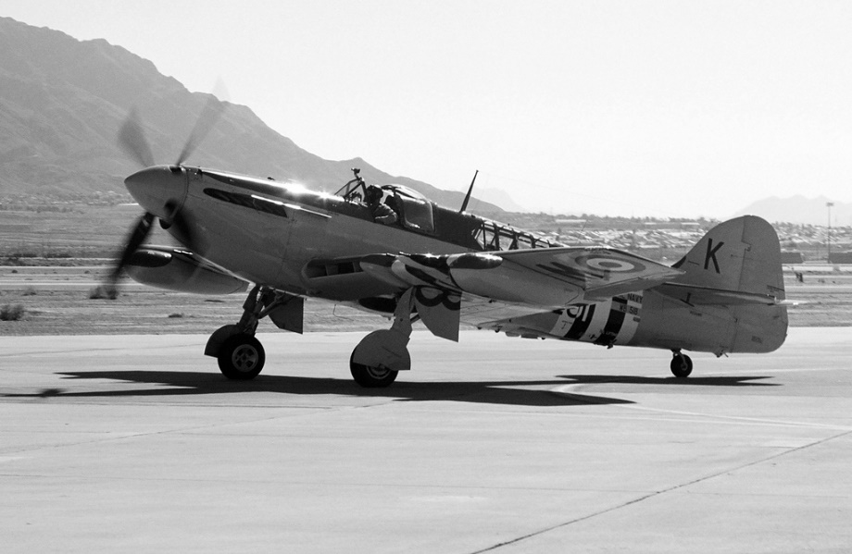
Project Overview
The United States Air Force decided to acquire new planes for screening potential pilots
T-41 Cessina
T-3 Firefly
Stable, slow, easy-to-pilot, aging
Aerobatic, fast, more difficult,
commercial
UConn – OPIM 5270 – Team 7

Slide 4

Project Timeline
October of 1994: After brief testing, plane accepted for use
June of 1993: First prototype of the modified T-3 is completed
April of 1992: Mechanical modifications necessary to use the T-3 begin
Sept of 1991: A Commercial-of-the-Shelf option is selected, and the T-3 is selected as the plane
July of 1991: Evaluation begins after acting head of Air Force determines that a new training airplane is necessary
UConn – OPIM 5270 – Team 7

Slide 5
Project Failure
Feb of 1995: Trainer unable to stabilize plane with a student piloting, plummeting into Colorado pasture and causing two deaths
Sept of 1996: Another incidents with pilot unable to stabilize the aircraft, resulting in two more deaths
June of 1997: Third and final incident, resulting in two more deaths
1998: Testing reveals several faults; TIME Magazine investigates the project
October of 1999: Fleet is retired as a training craft
UConn – OPIM 5270 – Team 7

Slide 6
Cognitive Biases
UConn – OPIM 5270 – Team 7

Slide 7
Considerations
Selective Perception
Groupthink
Insensitivity to sample size
Hindsight
Overconfidence
Conjunctive Events
Misconception of Chance
Confirmation Trap
Curse of Knowledge
UConn – OPIM 5270 – Team 7

Slide 8

Groupthink Bias
That’s a great idea!
Maybe!
Hey team – here’s an idea!
No we are doomed!
Ridiculous!
What does each individual think?
UConn – OPIM 5270 – Team 7

Slide 9
Groupthink Bias
What do they say?
So, do we all agree?!
Yes!
Absolutely!
Agree!
Yes I do!
Better say yes!
Maybe
he is right!
Am I the only one who disagrees?
Who cares!
What do they think?
UConn – OPIM 5270 – Team 7

Slide 10
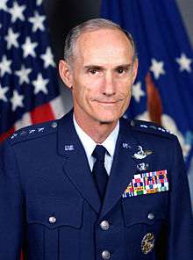
UConn - OPIM5270 - Team 7 - 9
Groupthink Applied
“The T-41 is your grandmother’s airplane. Our mission is to train warrior-pilots, not dentists to fly their families to Acapulco.”
General Merrill McPeak
“The Air Force brass, eager to please the boss, bought the 1,750-lb. English-manufactured Slingsby T-3 and made it mandatory for all cadets to fly the craft if they want to earn their wings.”
Thompson from TIME
General Merrill McPeak
Air Force Chief of Staff
Strongest Supporter of T-3 Firefly
Former member of precision flying team
UConn – OPIM 5270 – Team 7

Slide 11
Conjunctive Events
When an individual tends to overestimate the probability of success of conjunctive events (Course Notes, Lecture 3)
Adjusts our frame of reference:
What is the probability that the T-41 will be successfully replaced by the T-3 Firefly?
versus
What is the probability that each particular task required to transition planes will succeed when it needs to?
UConn – OPIM 5270 – Team 7

Slide 12
Conjunctive Events Applied
What are the chances of success in changing from one plane to another?
100%
An Example with Fictitious Numbers
Chance of Success
50%
0%
Activity
UConn – OPIM 5270 – Team 7

Slide 13
Conjunctive Events Applied
What are the chances of success in changing from one plane to another?
100%
T-3 was the U.S. Air Force’s first COTS airplane acquisition
“A commercial-off-the-shelf item is one that is sold, leased, or licensed to the public...and used without modification of the internals.”
Commercial Item Acquisition, 2000, pg. 3
Chance of Success
50%
0%
COTS Acquisition
Activity
UConn – OPIM 5270 – Team 7

Slide 14
Conjunctive Events Applied
What are the chances of success in changing from one plane to another?
100%
119: Number of Changes Recommended by Manufacturer, including Engine
131: Number of Required Modifications
Chance of Success
50%
0%
Mechanical Adjustments
Activity
UConn – OPIM 5270 – Team 7

Slide 15
Conjunctive Events Applied
What are the chances of success in changing from one plane to another?
100%
8 Days for Testing
Tested in Different Geography
Tested by Manufacturer Pilots
Chance of Success
50%
0%
Testing
Activity
UConn – OPIM 5270 – Team 7

Slide 16
Conjunctive Events Applied
What are the chances of success in changing from one plane to another?
100%
Hondo, TX v. Air Force Academy
5,000 Foot Elevation Difference
Very Different Air Pressure
Chance of Success
50%
0%
Geography
Differences
Activity
UConn – OPIM 5270 – Team 7

Slide 17
Conjunctive Events Applied
What are the chances of success in changing from one plane to another?
100%
Transition away from the plane as a screening tool and more focus on the training component
Chance of Success
50%
0%
New Training Philosophy
Activity
UConn – OPIM 5270 – Team 7

Slide 18
Conjunctive Events Applied
We have to look at all required events together to get an accurate idea
92%
85%
90%
87%
92%
100%
Chance of Success
50%
0%
COTS Acquisition
Mechanical Adjustments
Geography
Differences
Testing
New Training Philosophy
UConn – OPIM 5270 – Team 7

Slide 19
Conjunctive Events Applied
COTS
Geography Difference
Philosophy Shift
Mechanical Adjustments
Testing
Interdependent events and tasks that are more risky when treated conjunctively and rushed through to complete a project
“What was the rush? Why as such a degree of concurrency necessary? This was no wartime emergency, no crisis “ (Baker, 2003, p. 56)
UConn – OPIM 5270 – Team 7

Slide 20
Conclusions
UConn – OPIM 5270 – Team 7

Slide 21

Lessons Learned – Groupthink
Institutional Feedback Changes
More developed methods to communicate feedback on projects, i.e., using the Delphi method to avoid conflicts of interest
External Voices
Invite external subject matter experts into the organization to evaluate proposed changes
Military institutions are very vulnerable to groupthink
Operational Changes
Groupthink is increasingly becoming a part of military studies curriculum
Modify reporting structure to decentralize decision-making at the training level, forcing inter-organization collaboration opposed to top-down directives
(Mulrine, 2008)
UConn – OPIM 5270 – Team 7

Slide 22
Lessons Learned – Conjunctive Events
Three Ways to Increase Chance of Success:
Reduce the uncertainty in individual events
Reduce the concurrency of events
Reduce the number of events
“Like an aircraft, a project is a total system, in which all parts must fit together. This was not the case with the T-3”
(Baker, 2002, p. 56)
Treat the project like a system
UConn – OPIM 5270 – Team 7

Slide 23
Systems Approach Example
If we started over, here’s a high level look at how we would do it:
Develop COTS Acquisition Process
Develop New Screening Philosophy
Gather Plane Requirements
Test Airplane Models
Prepare for Implementation
Acquire the Selected Model, if COTS option selected
Autonomous tasks that are finish-to-start in nature
Develop Test Requirements
UConn – OPIM 5270 – Team 7

Slide 24
Questions?
UConn – OPIM 5270 – Team 7

Slide 25
Works Referenced
Baker, B. (2002). The fall of the firefly: An assessment of a failed project strategy [Electronic version]. Project Management Journal; 32(3); 53-57.
Meredith, J.R., & Mantel, S.J., Jr. (2000). Project Management: A managerial approach (4th ed.). New York John Wiley & Sons Inc.
Mulrine, A. (2008). The army trains a skeptics corps to battle groupthink [Electronic version]. US News; May 15, 2008.
Office of the Secretary of Defense. (2000). Commercial item acquisition: Considerations and lessons learned.
Scott, W.B. (1998) USAF modifying Slingsby trainers to correct inflight engine shutdowns [Electronic version]. Aviation and Space Technology; 148(2), 38.
The making of a trainer: The Air Force’s acquisition of the hapless Slingsby T-3A. (1998, February) Light Plane Maintenance, 20(2), 5-11; 22-23.
Thompson, M. (1998). The deadly trainer [Electronic version]. TIME, 151(1), 42-45.
Additional course lecture notes from the Fall 2016 semester of Introduction to Project Management
UConn – OPIM 5270 – Team 7

